Slide 1
CSE 8A – Introduction to Programming and Computational Problem Solving I
CS1-LLMs Materials © 2023 by Leo Porter, Dan Zingaro, Beth Simon, and Christine Alvarado is licensed under CC BY-NC-SA 4.0
Finish Images and Start Games
Remote Lecture
(Thanksgiving)
How to get help:
Class Website
https://sites.google.com/ucsd.edu/cse8afa23/home
Piazza for brief questions or logistic questions
Tutor Hours for help with homework/setting up computer To get help, use Autograder (directions on piazza)
Office Hours for homework/conceptual help
Slides based, in part, on materials from Dan Zingaro and Christine Alvarado
Notes:
Gave this lecture remotely (as a video) to support holiday travel for the students. Had a bit less interactivity built in because I suspected students were less apt to engage with the activities.

Slide 2
Announcements
Happy Thanksgiving!!!
Reading quiz due Tuesday 11/21 at noon
Complete before watching this video
Quiz 4 – 12/6 (Week 10)
Code writing only. Guide released.
Project 2 – Images (hard deadline 11/27)
No lab or discussion this week (Week 8)
Project 3 on games coming soon!

Slide 3
Learning Goals for Today
By the end of today’s lecture, you should be able to:
Read and modify Python code that manipulates images using the Pillow (PIL) library
In particular, edge detection
Describe and implement the game design cycle in Python
Author a small game in Python

Slide 4
Edge Detection

Slide 5
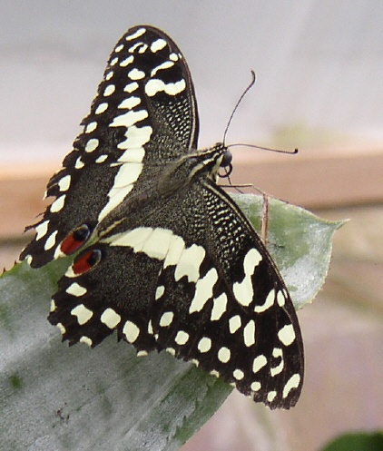
Edge Detection
def edgeDetection(image):
result = image.copy()
width, height = result.size
for x in range(0,width):
for y in range(0,height-1):
r1, g1, b1 = result.getpixel((x,y))
r2, g2, b2 = result.getpixel((x,y+1))
topAve = (r1+g1+b1)//3
bottomAve = (r2+g2+b2)//3
if abs(topAve-bottomAve) < 10:
result.putpixel((x,y), (255,255,255))
else:
result.putpixel((x,y), (0,0,0))
return result
What is it doing?
Comparing 2 pixels side by side and, if they are similar make the pixel white, otherwise black
Comparing 2 pixels one on top of the other and, if they are similar make the pixel white, otherwise black
Comparing 2 pixels side by side and, if they are different make the pixel white, otherwise black
Comparing 2 pixels one on top of the other and, if they are different make the pixel white, otherwise black
Notes:
Answer: B
Talk about why it is (height-1)
Primary Purpose: Read and understand code to see that y and y+1 makes it top and bottom, and to get them to ask about average and Math.abs (not really covered before this)
General Purpose: Have students read and understand the “goal” of a piece of code – know that the desired result of looking at a piece of code is to see as a whole what it’s purpose is.
Expected Mistakes: A) mixing up x and y (thinking y is horizontal), C) misunderstanding that taking the difference of two avg pixel colors should lead to a small number if they are “similar” D) combination of A and C mistakes
Post Discussion: Emphasize that asking what a code does means figuring out a real purpose than can be explained in English. Also, possibly giving examples of color averages, and using a specific example to work out the if statement.

Slide 6
What’s the result of running that code on this input?
Notes:
Answer: C
Primary Purpose: Have students apply understanding of code to a “corner case” problem where it doesn’t do as expected
General Purpose: Have students get experience predicting what a code would do, without running it and being able to spot logical bugs in a program
Expected Mistakes: A) seems right since this is edge detection, but we’re only detecting edges (x,y) to (x,y+1), maybe all black if they mistake that same is “white”
Post Discussion: (don’t until after isomorphic)

Slide 7
A DIFFERENT edgeDetect
def edgeDetection2(image):
result = image.copy()
width, height = result.size
for x in range(0,width-1):
for y in range(0,height):
r1, g1, b1 = result.getpixel((x,y))
r2, g2, b2 = result.getpixel((x+1,y)) # was (x,y+1)
topAve = (r1+g1+b1)//3
bottomAve = (r2+g2+b2)//3
if abs(topAve-bottomAve) < 10:
result.putpixel((x,y), (255,255,255))
else:
result.putpixel((x,y), (0,0,0))
return result
Notes:
This one is left to right. Rename the variables.

Slide 8
What’s the result of running that code on this input?
Notes:
Answer: C (the average of green, red, and blue is the same – so in gray, this is one color, so no edges are found). Perhaps too hard of a question, but brings up a good discussion of grayscale and how a better edge detector may look for differences in any channel rather than differences in gray.
Primary Purpose: Have students analyze a code change and getting into the details of grayscale
General Purpose: Reinforce the previous question, analyze code and predict output without running it, identify “purpose” of changes made in a code
Expected Mistakes: A) sticking with the original answer, B) perhaps thinking somehow the switch should apply to directions?
Post Discussion: Go back and show the two codes again – pointing out the differences. Draw an example of pixels (boxes) maybe 3 by 3 and show which would be compared for each code. Point out that this will find the edges, BUT

Slide 9
Edge Detection
Additional Steps
Add threshold as a parameter
If you want to create a sketch - just replace the decision of either pure white or black with the difference between pixels
For better edge detection, look left->right, up->down, diagonals, any edge counts

Slide 10
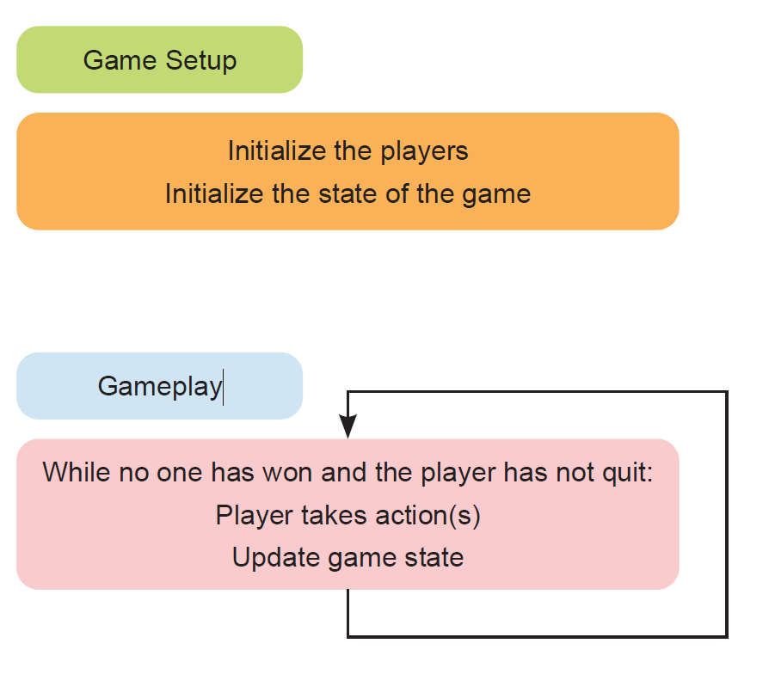
Designing Games!
Figure from Porter and Zingaro. Manning Press, 2023.

Slide 11
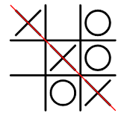
Tic Tac Toe
3 x 3 game board
Players take turns placing an X or O
First to 3 in a row wins
Notes:
List of List

Slide 12
Tic Tac Toe – Game Setup
How should we represent the game board?
Dictionary
List
List of Lists
String
List of Strings
Notes:
We’ll go with a List of Lists. You might imagine a List of Strings as a viable alternative. Really, there’s a way to make any of these work, per-se, but a List of Lists is the most direct representation of the actual game board.

Slide 13
Tic Tac Toe – Game Setup
def setup():
"""
Create a game board for tic tac toe
Return the board as a 2D list of empty strings
"""
board = [[" ", " ", " ",],[" ", " ", " ",],[" ", " ", " ",]]
return board
Notes:
Copilot’s answer was a bit verbose (loops to create board, etc.) so I trimmed it down.

Slide 14
Tic Tac Toe – How do we know if it’s working?
def print_board(board):
"""
Print the game board
"""
print(" 1 2 3")
for i in range(3):
print(str(i+1) + " " + board[i][0] + "|" + board[i][1] + "|" + board[i][2])
if i < 2:
print(" -----")
Notes:
Copilot wrote this one, did pretty well. Demo it running and actually adding some nice spacing for making the board look nice. I suspect Tic-Tac-Toe might be in its training set. ☺

Slide 15
Tic Tac Toe – Play Game
General idea:
Start with a player (“X” or “O”)
Until game is over:
Print the board
Ask for row/column for letter
Insert the letter of the player at that location
Swap player
Check if there was a win or tie, report winner.
Notes:
Say that we may want to move the swap player earlier, but let’s go with this for now.

Slide 16
Tic Tac Toe – Top Down Design
setup_board
print_board
main
insert_letter
play_game
check_winner
check_full
Notes:
We’ve already done setup_board and print_board

Slide 17
Tic Tac Toe – insert_letter
def insert_letter(board, letter, row, col):
"""
Insert a letter into the game board
"""
board[row][col] = letter
Notes:
Not particularly difficult, might not even need a function for this in retrospect, but let’s leave it for now.

Slide 18
Tic Tac Toe – Check Winner
def check_winner(board):
for i in range(3):
if board[i][0] == board[i][1] == board[i][2] != " ":
return True
for i in range(3):
if board[0][i] == board[1][i] == board[2][i] != " ":
return True
if ___________________________________
return True
if board[0][2] == board[1][1] == board[2][0] != " ":
return True
return False
Notes:
Talk through the first 6 lines. Checks rows, then checks columns.
What line belongs here? We need the top left -> bottom right
board[0][0] == board[1][1] == board[2][2] != " ":

Slide 19
Tic Tac Toe – Check Full
To check if the board is full, what’s going to be easier?
Check that every element is full
Check for an empty element
Notes:
Probably look for an empty element, it’s a bit faster.

Slide 20
Tic Tac Toe – Check Full
def check_full(board):
for i in range(3):
for j in range(3):
if board[i][j] == " ":
return False
return True
Notes:
Goes through all the rows and columns. Once it finds one that’s empty, it’s done!

Slide 21
Tic Tac Toe – Play Game
def play_game(board):
"""
play the game of tic tac toe. Alternate players starting
with X. Prompt the player for a row and column to place their
letter. Check for a winner after each move. If there is a winner
print the board and print the winner. If there is a full board
print the board and print "Tie game".
"""
Notes:
This was my prompt to copilot

Slide 22
Tic Tac Toe – Play Game
def play_game(board):
player = “X"
while not check_winner(board) and not check_full(board):
print_board(board)
row = int(input("Enter a row: "))
col = int(input("Enter a column: "))
insert_letter(board, player, row-1, col-1)
if player == "X":
player = "O"
else:
player = "X"
print_board(board)
if check_winner(board):
print(player + " wins!")
else:
print("Tie game")
Notes:
Code that came back. Talk through each part, then demo it.
But this doesn’t work right for reporting the winner…. Let’s fix this with live coding.

Slide 23
Tic Tac Toe – Play Game
def play_game(board):
player = "O"
while not check_winner(board) and not check_full(board):
if player == "X":
player = "O"
else:
player = "X"
print_board(board)
row = int(input("Enter a row: "))
col = int(input("Enter a column: "))
insert_letter(board, player, row-1, col-1)
print_board(board)
if check_winner(board):
print(player + " wins!")
else:
print("Tie game")

Slide 24
Tic Tac Toe – Run the game
board = setup()
play_game(board)
Notes:
Could put this in a loop if we want to play it many times.

Slide 25
Summary
The Pillow (PIL) library offers useful functions for working with images
We can manipulate images in a variety of ways, including copying, blending, flipping, mirroring, red-eye reduction, and edge detection (among many)
Created our first game together using the game design cycle and problem decomposition.
Your Project 3 will be to design a game or a game simulation (we’ll do an example of game simulation next Tuesday)

